Slide 1
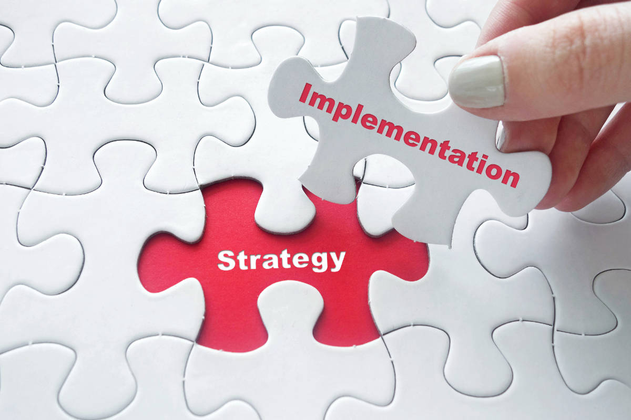
Implementing Strategy

Slide 2
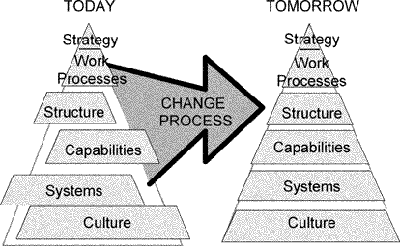
Implementing Strategy

Slide 3
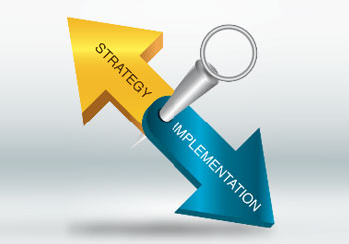
Implementing Strategy– What’s wrong?
75% of executive teams do not have a clear customer propositions (idea of the mix that appeals to the target market) (Kaplan & Norton, 2001).
20% of organisations take more than 16 weeks to prepare a budget, with many not completed by the start of the fiscal year (Many companies, 1999)
78% of companies do not change their budgets within the fiscal cycle, even if the rest of the world changes around them (Corporate strategic, 1999)
85% of management teams spend less than one hour per month discussing strategy (Norton, 1996)
60% of organisations don't link strategy and budgeting (Corporate strategic, 1999)
92% of organisations don't report on strategic lead indicators (Corporate strategic, 1999)
less than 5% of an organisation's workforce understands its strategy (Kaplan & Norton, 2001)
only 51% of senior managers, 21% of middle managers, and 7% of line employees have personal goals linked with strategy (Kaplan & Norton, 2001)
organisations find that up to 25% of strategy measures change each year (Kaplan & Norton, 2001)
tangible book value represented only 62% of industrial organisation's market value in 1982; in 1992 it was 38%, and 10-15% in 2000 (Blair, 1995; Webber, 2000).
the failure rate of strategies is between 70-90%, due primarily to poor implementation (Charan & Colvin, 1999; Keichel, 1982)
Notes:
1

Slide 4
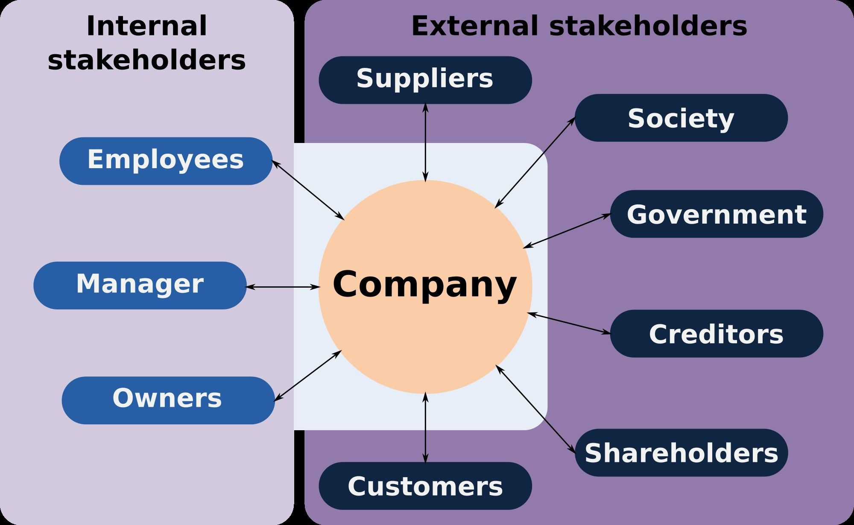
Analysing external stakeholder response to strategic moves
What are the stakeholder’s current goals and focus? What have they been in the past?
Where are their major long and short term resources and policy commitments directed?
Are they satisfied with their current position or is change likely? What changes are likely?
Where are they weak? Strong? In our eyes? In theirs?
What moves will provoke the greatest retaliation?
Are they inhibited from responding to strategic moves because:
  To match the moves would be counterstrategic?
  The move is regarded as nonthreatening?
  They are distracted by major problems or opportunities?
  The move is not visible to them?
  The threatened division has low priority in the larger organisation?
  No specific division is responsible or motivated to respond?
  A correct response calls for a major policy revision or costly revision of procedures?
  A response would create jurisdictional disputes and bureaucratic disruptions?

Slide 5
The Big-8 Components of
Strategy Implementation
Building an
organisation with the competencies, capabilities, and resource strengths needed for successful execution
Exercising the
strategic leadership needed to drive implementation
forward
Allocating ample resources to strategy critical activities
Strategy
Implementer’s Action Agenda
Shaping
the work environment
& corporate culture to
fit strategy
What to do now vs. later
What requires much time
& personal attention
What can be delegated to
others
Establishing strategy-supportive policies
Tying rewards
and incentives to achievement of strategic targets
Instituting best
practices & pushing for continuous improvement
Installing information, communication, and operating systems that enable company personnel to better carry out strategic roles proficiently
Notes:
2

Slide 6
Monitoring Implementation: Continuous Improvement
Financial
Goals/
Outcome
Interpret
(analyse)
Customer
Target/
Objectives
Application
(modify/correct)
Reflect
(monitor)
Initiative
Internal
Performance
Indicator
Implement
Who?
What?
When?
Where?
How?
Growth & Development
Notes:
4

Slide 7
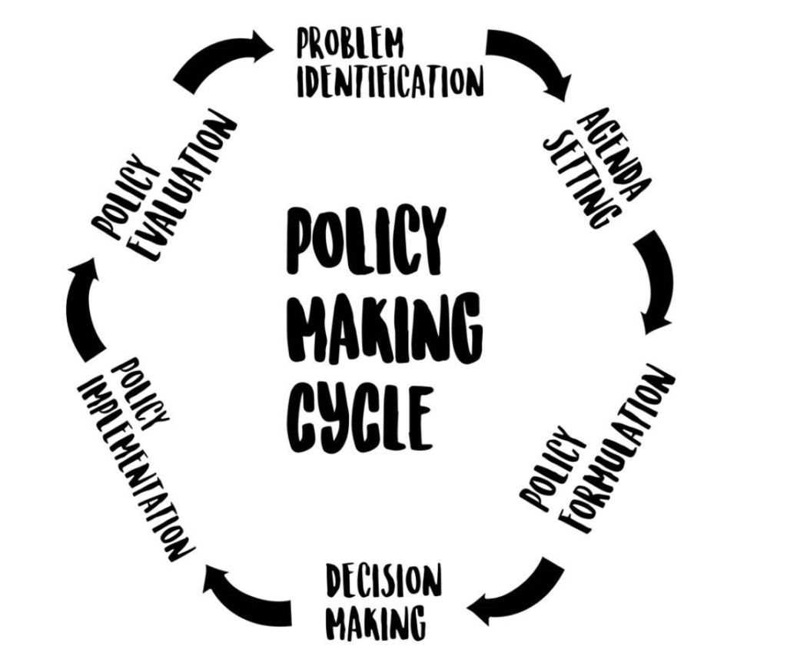
The Role of Policy: reduce variation, institutionalise standard operating procedures, channel synergy, counteract resistance to change
Policy institutionalises strategy-supportive practices & operating procedures thereby pushing daily activities in the direction of efficient strategy execution
Policy limits independent action and discretionary decisions and behavior. Policy communicates what is expected, guides strategy-related activities, and restricts unwanted variations
Policy aligns actions & behaviors with strategy, thereby minimizing divergent decisions and conflict
Policy helps shape character of work environment and translates corporate philosophy into how things are done, how people are treated, and what corporate beliefs and attitudes mean in everyday terms; determines the fit between corporate culture & strategy
Notes:
5

Slide 8





Key checkpoints for strategy compatibility
Organisational
Structure
Corporate Culture
Skills & Competencies
Strategy
Reward Structure
Budget Allocations
How well do these complement, support, and reflect strategy?
Notes:
6

Slide 9
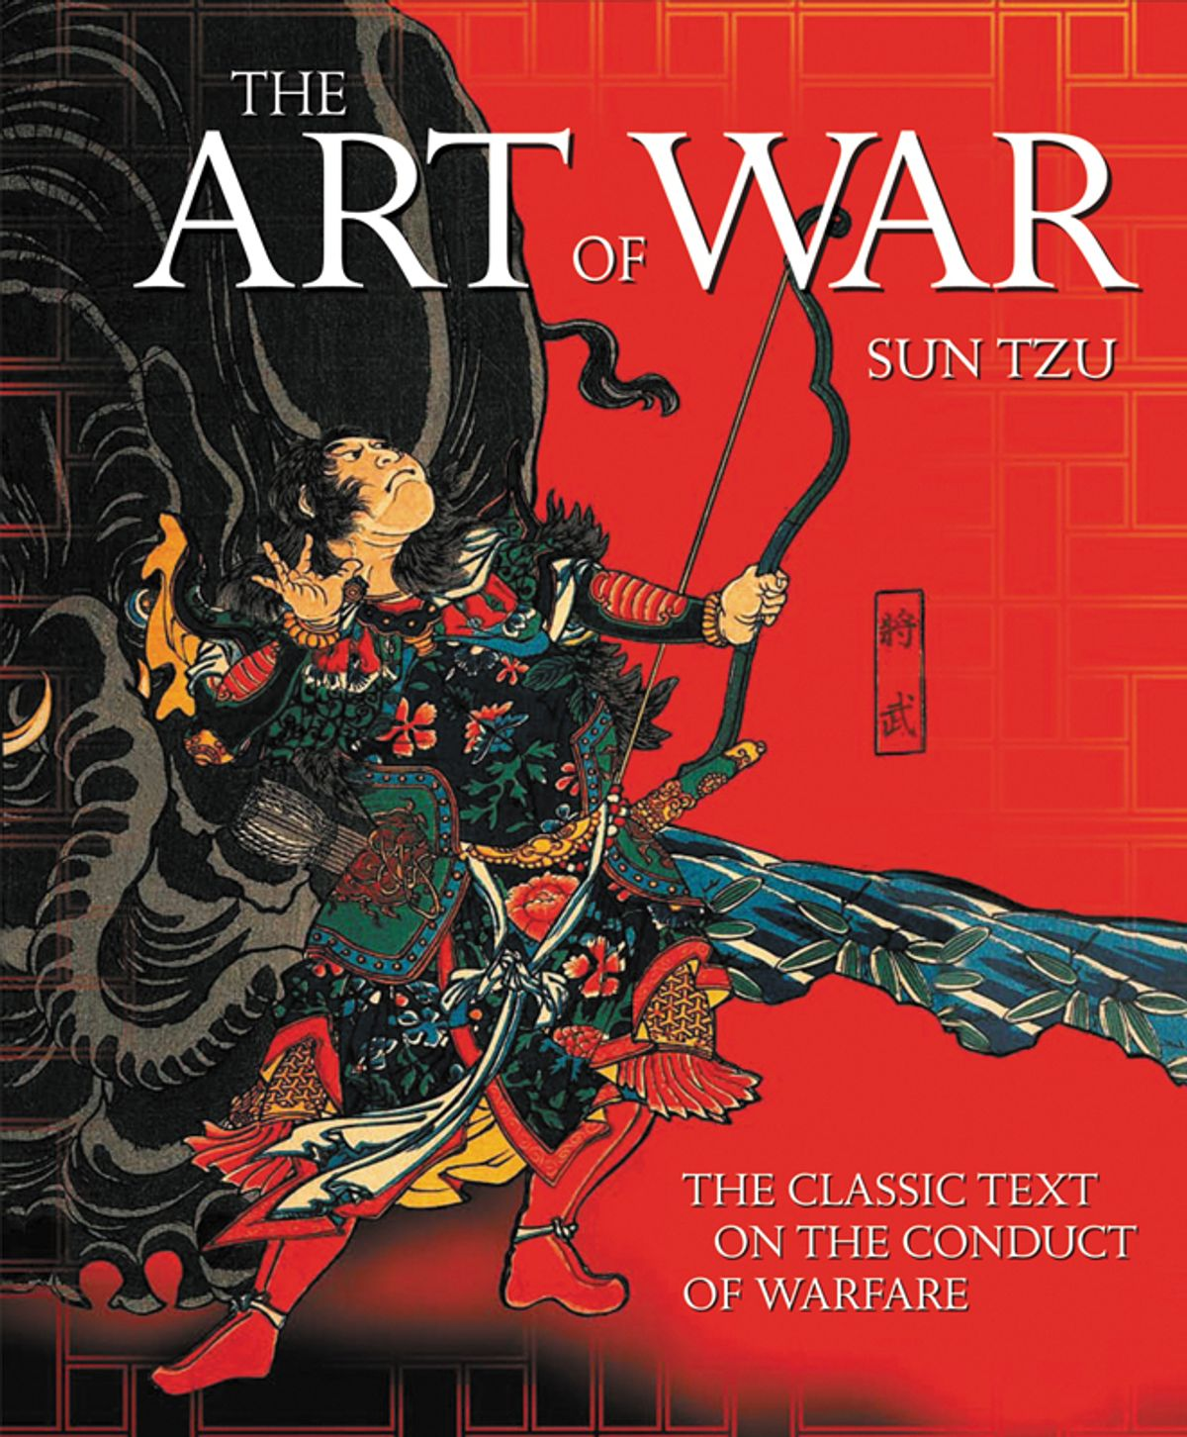
Strategy as The Art of War
Don’t start what you shouldn’t begin
The impossible is impossible
Don’t attack a tank with a peashooter
Attack what isn’t defended
If you can’t attack, defend
Illusion creates confusion
Do what they don’t expect
Rather than assume they won’t attack, position yourself so they can’t
The unprepared can be defeated
The unknowing can be outsmarted
Do not challenge unless you have the means to win
Do not fight unless you’re determined to win
Notes:
9

